Slide 1
Guideline for TAS2781 Linux driver based on BBB
Kernel-5.10-rt

Slide 2
Revision history
Ver | Date | Author | Description
1.0 | 2022/9/14 |  | Initial
1.1 | 2022/9/20 |  | 1st round Review & rework
1.2 | 2022/9/30 |  | Add tinyalsa
1.3 | 2022/10/8 |  | 2nd round Review & rework
1.4 | 2022/10/10 |  | Add CONFIG_COMPAT and FTC section

Slide 3
Information
tasdevice Driver | tas2781
7-bit I²C Address | 0x38 ~ 0x3F
Platform | Qualcomm/Mtk/LSI/BeagleBone Black/AMBA
Architecture | ALSA/Tiny-ALSA
Bus type | I2C
Kernel Version | V4.19 ~ V5.10

Slide 4
Release Package
Driver Package | Kconfig, Makefile | Config for compiling
 | .c, & .h, | Source code
 | dts.readme | Sample for dts setting
 | regbin.json | File to generate a sample register setting file with Regbin tool.
 | dspfw.json | File to generate a sample dsp firmware and acoustic params file with PPC3 tool.
 | Verification report
 | .ftcfg file | Store speaker basic characterization params for speaker calibration
Tool_utility | FTC_tool | Source code for calibration
Kernel Version | PPC3 tool | Tool for sample dsp firmware and acoustic params and ftcfg file
 | Non_Integrated_Bin_Tool_v1.3.4 | Tool for regbin

Slide 5
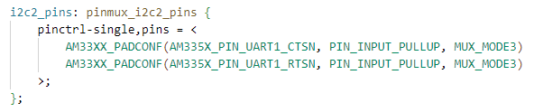
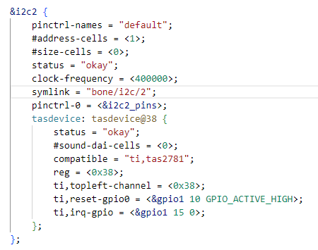

Device Tree | I2C
Configuration in DTS:
How to check device
If the I2C is successfully registered, Check device through below commands, 2-0038 is the registered device. 0x38 is the i2c address for slave device.
# ls /sys/bus/i2c/device/
DTS file:

Slide 6
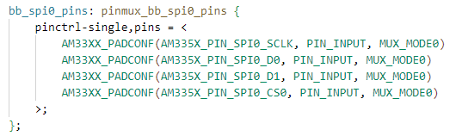
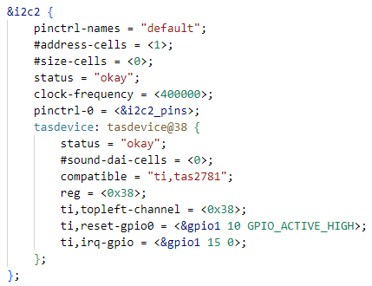
Device Tree | SPI
Configuration in DTS:
How to check device.
If the SPI is successfully registered, Check device through below commands, spi0.0 is the registered device.
# ls /sys/bus/spi/device/
DTS file:

Slide 7
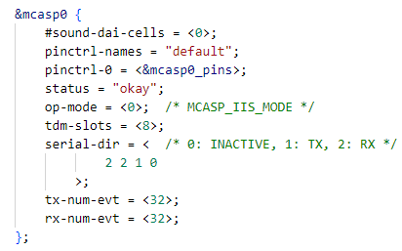
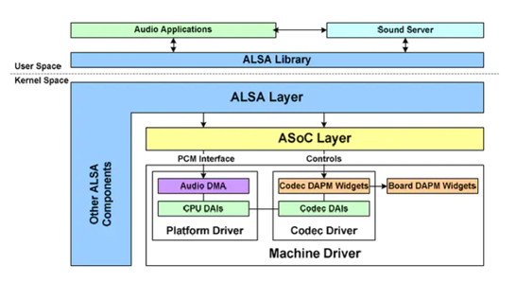
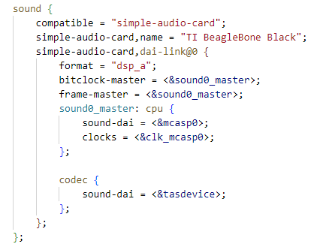
Device Tree | Sound card

Slide 8
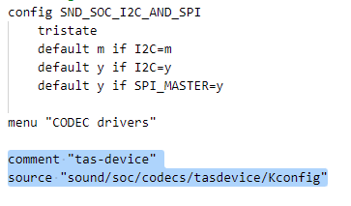
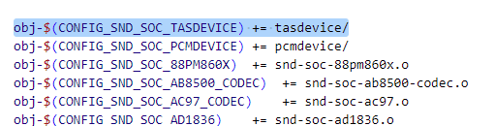
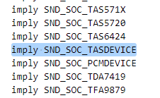
Kconfig & Makefile
Kconfig in sound/soc/codecs
Makefile in sound/soc/codecs

Slide 9
Modification in defconfig for I2C interface
Check whether following items have been enabled in arch/arm/configs/ti_sdk_am3x_release_defconfig, if not, enable them as following
CONFIG_I2C=y
CONFIG_I2C_GPIO=y
CONFIG_I2C_OMAP=y
CONFIG_I2C_MUX=y

Slide 10
Modification in defconfig for SPI interface
Check whether following items have been enabled in arch/arm/configs/ti_sdk_am3x_release_defconfig, if not, enable them as following
CONFIG_SPI=y
CONFIG_SPI_GPIO=y
CONFIG_SPI_SPIDEV=y
CONFIG_SPI_MASTER=y

Slide 11
Modification in defconfig for Sound Card based on I2C or SPI
Add following items in arch/arm/configs/ti_sdk_am3x_release_defconfig.
CONFIG_SOUND=y
CONFIG_SND=y
CONFIG_SND_SOC=y
CONFIG_SND_SIMPLE_CARD=y
CONFIG_SND_SOC_TASDEVICE=y
CONFIG_TASDEVICE_CODEC=y

Slide 12
CONFIG_COMPAT
Enable CONFIG_COMPAT on 64-bit kernel
The whole point of CONFIG_COMPAT is to allow running 32-bit userspace code on a 64-bit kernel. So no, it doesn’t need to enable on a 32-bit kernel.

Slide 13

Firmware Setting in defconfig
Compile the bin file into image.
Add following settings into defconfig file
CONFIG_EXTRA_FIRMWARE_DIR is path where the bin file is stored into the kernel root. “firmware” is the relative path in the compiling base path.
CONFIG_EXTRA_FIRMWARE is the name of firmware name. if multiple bin files are required,
input the file name format like CONFIG_EXTRA_FIRMWARE = “a.bin b.bin c.bin”
If this method is enabled, the fw will be loaded during system bootup.
During debug, pushing the bin file into proper folder of the target device is more convenient than compiling into image. Once compiling into zImage, every time the bin file is changed, it should be recompiled into zImage instead of copied into the fw_path

Slide 14
Firmware & ftcfg file naming
file | File name | Remark
regbin | tas2781_regbin.bin | Generated by regbin tool
Dsp firmware & params | tas2781_dsp.bin | Generated by ppc3
ftcfg | tas2781_0x38.ftcfg tas2781_0x39.ftcfg … | Generated by ppc3
Calibrated file | tas2781_cal_0x38.bin tas2781_cal_0x39.bin … | Generated by ftc tool

Slide 15
Compile Image with tas2781 driver
Generate .config
#sudo make ARCH=arm CROSS_COMPILE=arm-linux-gnueabihf- ti_sdk_am3x_release_defconfig
Compile the image
#sudo make ARCH=arm CROSS_COMPILE=arm-linux-gnueabihf- zImage dtbs -j16

Slide 16
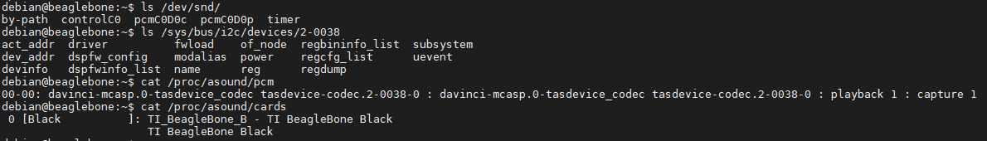
Audio card registration
BBB use mcasp0 to output the audio data. If the DTS was configured correctly, the driver will create sound card device and kcontrols, we can check below commands to confirm that.
# ls /dev/snd
# ls /sys/bus/i2c/devices/2-0038
# cat /proc/asound/pcm
# cat /proc/asound/cards

Slide 17
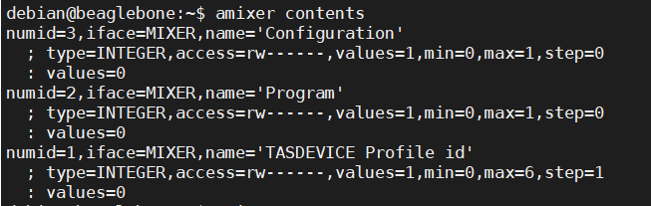
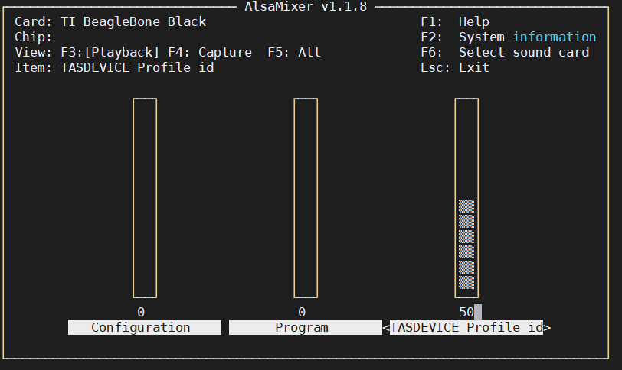
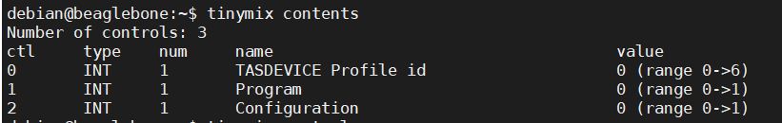
Audio card | Kcontrols
Please use below commands to check Kcontrols created in driver.
#amixer contents
#tinymixer contents
Also we can use Graphical interface to adjust these kcontrols. Push esc to exit.
#alsamixer

Slide 18

Driver nodes I | Introduction
In order to debug driver freely, several driver nodes have been defined,
Check below path to access above driver nodes
/sys/bus/i2c/devices/2-0038
/sys/class/i2c-adapter/i2c-2/2-0038
/sys/class/i2c-dev/i2c-2/device/2-0038

Slide 19


Driver nodes II | i2caddr/devinfo
#cat dev_addr
Illustration: show the active i2c address
#cat devinfo
Illustration: Get the basic information of audio device on the board

Slide 20

Driver nodes II | reg
#echo chn 0xBK 0xPG 0xRG 0xXX > reg
Illustration: Write a value to a certain register
chn is channel no, must be 1-digital
BK, PG, RG & XX must be 2-digital HEX
eg: 0 0x00 0x00 0x05 0x07 > reg
#cat reg
Illustration: Read back the value from the register which have been echoed before

Slide 21
Driver nodes III | regdump
#echo chn 0xBK 0xPG > regdump
Illustration: the command dump all the registers of the specific page
chn is channel no, must be 1-digital
BK & PG must be 2-digital HEX
#cat regdump
Illustration: run the echo command, show the 7-bit i2c address of the chip and dump the registers

Slide 22
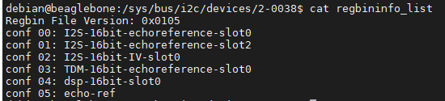
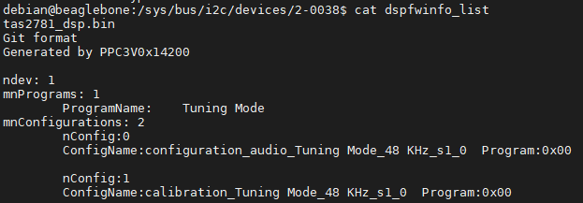
Driver nodes IV | regbininfo_list &
#cat regbininfo_list
Illustration: list the regbin version and dump the name of all the audio cases from regbin file, If wanted detailed info from specific audio case, kindly use the drive node regcfg_list
#cat dspfwinfo_list
Illustration: list the detail of fwdsp bin file and dump the program name and configuration name.

Slide 23
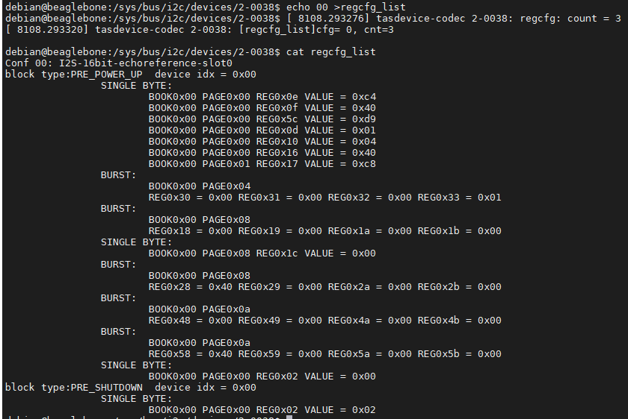
Driver nodes V | regcfg_list
#echo CG > regcfg_list
CG is conf NO, it should be 2-digital decimal
eg: echo 00 > regcfg_list
#cat regcfg_list
Illustration: dump the register setting of the audio case specified by echo command

Slide 24
Bypass mode
Write a shell script to test bypass mode. Use #amixer contents to check the kcontrol list, then set the parameters we used. “Program” is 0 when only use tuning mode.
PS: for detail about porting Tinyalsa, please see appendix.
Shell script with Alsa
#! /bin/bash
amixer cset numid=1,iface=MIXER,name="Program" 1
amixer cset numid=3,iface=MIXER,name="Configuration" 0
amixer cset numid=2,iface=MIXER,name='TASDEVICE Profile id' 0
aplay --device="hw:0,0" test.wav &
sleep 1
amixer cset numid=2,iface=MIXER,name='TASDEVICE Profile id' 5
arecord -c 2 -f S16_LE -r 48000 -d 15 --device="hw:0,0" 16bit-echoref.wav &
Shell script with Tinyalsa
#! /bin/bash
tinymix set "Program" 1
tinymix set "Configuration" 0
tinymix set "TASDEVICE Profile id" 0
tinyplay test.wav &
sleep 1
tinymix set 'TASDEVICE Profile id' 5
tinycap 16bit-echoref.wav &

Slide 25
Tuning mode
Write a shell script to test tuning mode. “Program” is 1 when use tuning mode, then select the configuration number.
PS: For details about fwdsp bin file, please use “cat dspfwinfo_list”.
Shell script with Alsa
#! /bin/bash
amixer cset numid=1,iface=MIXER,name="Program" 0
amixer cset numid=3,iface=MIXER,name="Configuration" 0
amixer cset numid=2,iface=MIXER,name='TASDEVICE Profile id' 4
aplay --device="hw:0,0" test.wav &
sleep 1
amixer cset numid=2,iface=MIXER,name='TASDEVICE Profile id' 5
arecord -c 2 -f S16_LE -r 48000 -d 15 --device="hw:0,0" 16bit-echoref.wav &
Shell script with Tinyalsa
#! /bin/bash
tinymix set "Program" 0
tinymix set "Configuration" 0
tinymix set "TASDEVICE Profile id" 4
tinyplay test.wav &
sleep 1
tinymix set 'TASDEVICE Profile id' 5
tinycap 16bit-echoref.wav &

Slide 26
FTC Tool Package
Makefile in the package is for arm-linux-gnuebinf
Generate tool
# make
Makefile.x86 in the package is for x86
Generate tool
# make –f Makefile.x86
Assign permissions to tas2781_ftc
# chmod 777 tas2781_ftc

Slide 27
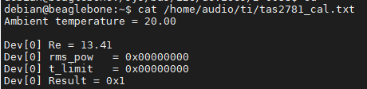
FTC tool
Run FTC tool with root permission
# sudo ./tas2781_ftc
Put TAS2781-A.ftcfg file (Generated by ppc3) into direction: /mnt/vendor/persist/audio/
After the calibration process finished, the results save into /home/audio/ti/tas2781_cal.txt

Slide 28
Calibration test
It’s necessary to enable IV sense in PPC3.
Write a shell script to test calibration. Select calibration_tuning_mode 1 in “configuration”.
Shell script with Alsa
#! /bin/bash
amixer cset numid=1,iface=MIXER,name="Program" 0
amixer cset numid=3,iface=MIXER,name="Configuration" 1
amixer cset numid=2,iface=MIXER,name='TASDEVICE Profile id' 4
aplay --device="hw:0,0" silence.wav &
sleep 15
./tas2781_ftc
Shell script with Tinyalsa
#! /bin/bash
tinymix set "Program" 0
tinymix set "Configuration" 1
tinymix set "TASDEVICE Profile id" 4
tinyplay silence.wav &
sleep 15
./tas2781_ftc

Slide 29
Appendix

Slide 30
Kernel 5.10-rt
Download Kernel 5.10-rt for BBB from…
https://github.com/beagleboard/linux/tree/5.10-rt
# sudo unzip kernel-5.10-rt

Slide 31
Porting Tinyalsa I
Reference link: Tinyalsa - Tiny library to interface with ALSA in the Linux kernel - (tinyalsa) (opensourcelibs.com) Download link: GitHub - tinyalsa/tinyalsa: Tiny library to interface with ALSA in the Linux kernel
copy driver code into /usr/local on BBB.

Slide 32
Porting Tinyalsa II | Steps of installation
Modify cross compile, add below statements into top of Makefile. export ARCH = arm export CROSS_COMPILE = arm-linux-gnueabihf- export CC = $(CROSS_COMPILE)gcc
Assign permissions to scripts in tinyalsa package #chmod 777 script
To build and install with Make, run the commands: # sudo make # sudo make install # sudo ldconfig
Once installed, the man pages are available via: # man tinyplay # man tinycap # man tinymix # man tinypcminfo

Slide 33
Thanks!

